Slide 1

ONLINE BUS BOOKING SYSTEM
GROUP- 08
AirBus

Slide 2
TEAM MEMBERS
Employee ID | Name
2496219 | D Nandhakumar
2495940 | Parise Ramesh
2496155 | Padileti Sandeep Reddy
2496160 | Gillella Jagadeshwar Reddy
2498756 | Vignesh Raaj N S
2499237 | vayyeti mahija
2496003 | Undavalli Tejendra
2496138 | Gummadipudi Goutham (Backend Lead)
2499086 | Rajagopal Saikrishna (Frontend Lead)
2499261 | Reddy Vari Vishnu Sai Abhilash Reddy
2496188 | Manish Kumar (TEAM LEAD)

Slide 3
TEAM DISTRIBUTION
Backend Team
Manish Kumar
Gummadipudi Goutham
Parise Ramesh (DBMS)
R.Vishnu Sai Abhilash
Gillella Jagadeshwar Reddy
Vignesh Raaj N S
Undavalli Tejendra
Padileti Sandeep Reddy
Frontend Team
Rajagopal Sai Krishna
Vayyeti Mahija
D Nandhakumar

Slide 4
INTRODUCTION
The Online Bus Booking System is a web-based application that allows a user to check ticket availability, buy ticket and pay for the bus ticket online.
The bus booking system is based on Java Spring Boot, MySQL and Angular. Role based authorization and authentication is given to both admin and user.

Slide 5
SCOPE
The scope of the online bus booking system is: A person should be able to:
Login to the system through the first page of the application.
Otherwise we can register into the system.
Should be able to create a new login for accessing the reservation facility.
Able to search and book the particular bus.

Slide 6
Technologies used in Backend :-
Spring Boot
Maven
Spring Data JPA
JDK 18
MySQL Database
Hibernate

Slide 7
Dependencies :-
Spring-Boot Data JPA :
Spring Boot provides spring-boot-starter-data-jpa dependency to connect Spring application with relational database efficiently. The spring-boot-starter-data-jpa internally uses the spring-boot-jpa dependency.
Spring-Boot Validation :
When Spring Boot finds an argument annotated with @Valid, it automatically bootstraps the default JSR 380 implementation — Hibernate Validator — and validates the argument. When the target argument fails to pass the validation, Spring Boot throws a MethodArgumentNotValidException exception.
Spring-Boot Dev Tools :
Spring Boot 1.3 provides another module called Spring Boot DevTools. DevTools stands for Developer Tool. The aim of the module is to try and improve the development time while working with the Spring Boot application. Spring Boot DevTools pick up the changes and restart the application.

Slide 8
My SQL-Connector :
MySQL provides connectivity for client applications developed in the Java programming language with MySQL Connector/J, a driver that implements the Java Database Connectivity (JDBC) API. MySQL Connector/J is a JDBC Type 4 driver. Different versions are available that are compatible with the JDBC 3.0 and JDBC 4.
Lombok :
Lombok is a popular and widely used Java library that is used to minimize or remove the boilerplate code. It saves time and effort. Just by using the annotations, we can save space and readability of the source code. It is automatically plugging into IDEs and build tools to spice up our Java application.

Slide 9
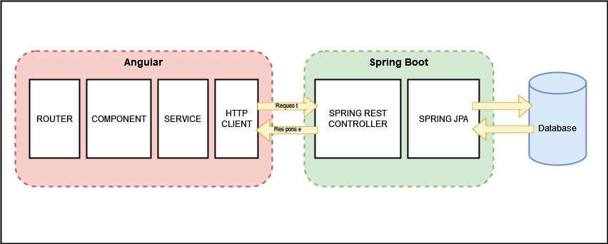
Web Application Block Diagram

Slide 10
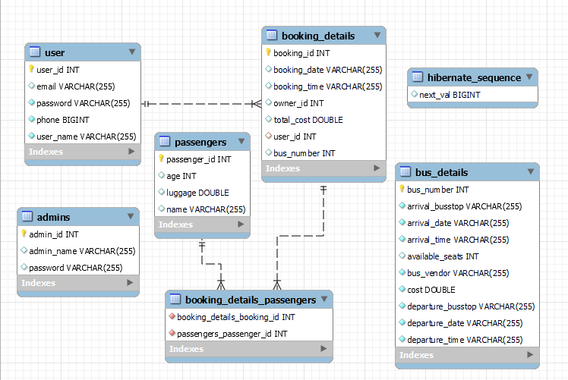
EER Diagram:

Slide 11
Modules in Backend :
Entity
Controller
DAO
Service
Service Implementation (ServiceImpl)
Util
Exception
Test Modules

Slide 12
Entity Module :
Entity module defines the basic entities required for this application that are stored in the database. Each entity is represented in the form of tables in the Database.
Those entities are
Admin: Defines the Admin entity with 3 properties which are Admin ID, Admin Name and Password.
Booking Details: Defines the entity with following properties. Booking ID, Booking Date, Booking Time, Total Cost, Bus Number and User ID.
Bus Details: It has following properties. Bus number, Departure stop, Arrival stop, Available seats, Departure date, Arrival date, Arrival time, Departure time, Bus vendor and Cost.
Passenger: It is defined with following properties Passenger ID, Name, Age and Luggage.
User: It has following properties such as User ID, User Name, Password, Email and Phone. User entity is related with Booking details entity in one to many relationship.

Slide 13
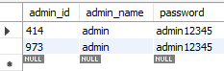
Admin Entity Class :
This Defines the Admin entity with 3 properties which are Admin ID, Admin Name and Password.
Admin ID - Primary key
Admin Name - Column
Password - Column

Slide 14
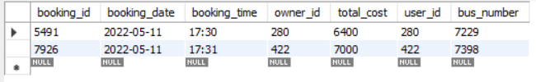
Booking Details Entity Class :
Defines the entity with following properties. Booking ID, Booking Date, Booking Time, Total Cost, Bus Number and User ID.

Slide 15
Bus Details Entity Class :
It has following properties. Bus number, Departure stop, Arrival stop, Available seats, Departure date, Arrival date, Arrival time, Departure time, Bus vendor and Cost.

Slide 16
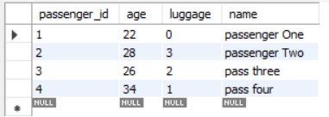
Passenger Entity Class :
It is defined with following properties Passenger ID, Name, Age and Luggage.

Slide 17
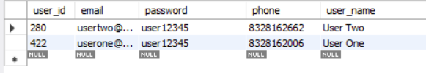
User Entity Class :
It has following properties such as User ID, User Name, Password, Email and Phone. User entity is related with Booking details entity in one to many relationship.

Slide 18
Dao Layer :
Data Access Object (DAO) pattern is a structural pattern that allows to isolate the application/business layer from persistence layer using an abstract API.
It is used to abstract the retrieval of data from a data resource such as a Database.
All the entity classes are extended to JPA repository in order to perform CRUD operations.
This application has DAO classes (or interfaces) for the defined entities, which are
Admin DAO
User DAO
Bus Details DAO
Booking Details DAO
Passenger DAO

Slide 19
Exception Module :
Exception module has all the exception handling classes defined, that are used in this application.
It provides the proper exception messages and error propagation mechanisms.
All the exception Classes will implement runtime exception.
Some of the exception handling classes used in the application are AdminDoesnotExist, NullAdmin, RecordNotFound, RecordAlreadyPresent, UserAlredyExist and etc.

Slide 20
Util Module:
This module has two classes.
Admin Authorization (AdminAuth)
User Authorization (UserAuth)
Both of these classes are used to set the Authorization values for the 2 entities namely Admin and User.
Admin entity has Admin ID and Password for admin login.
User entity has User ID and Password for user login.

Slide 21
Service and Service Implimentation Modules:
Service: The Service module declares the methods that are used by the entities.
Service module declares Admin Service and User Service classes which has many methods that are implemented in serviceImpl module.
Service Implementation (ServiceImpl): This module implements all the methods specified in the Service module classes. It also uses dependency injection technique to implement the Dao modules.
It defines the functions for both Admin Service and User Service classes.
Methods defined by this module are such as Add admin, Delete admin, Admin login, Add bus details, Update bus and etc. for Admin Service class and then User login, Add user, Delete user, Update user, Add booking, Delete booking and etc. for User Service class.

Slide 22
Service & SERVICEIMPL Methods
Admin Methods
public Admin addAdmin(Admin admin);
public Admin getAdmin(Integer adminId);
public void deleteAdmin(Integer adminId);
public Admin adminLogin(AdminAuth auth);
public List<BusDetails> getAllBusDetails();
public BusDetails addBusDetails(BusDetails details);
public void deleteBus(Integer busNumber);
public BusDetails updateBus(BusDetails details);
public List<Passenger> getAllPassengers();
public List<Passenger> getPassengersByBooking(Integer id);
User Methods
public User addUser(User user);
public void updateUser(User user);
public User getUser(Integer userId);
public void deleteUser(Integer userId);
public User userLogin(UserAuth auth);
public BookingDetails addBooking(BookingDetails booking, Integer userId, Integer busNumber);
public void deleteBooking(Integer bookingId, Integer userId);
public List<BookingDetails> getBookingByUserId(Integer userId);
public BusDetails findByRouteAndDate(String arrivalBusstop, String departureBusstop, String date);
public BusDetails getBusByBusNumber(Integer busNumber);
public Passenger updatePassenger(Passenger passenger);

Slide 23
Controller Module :
Controller module provides the HTTP request and response mappings for the entities in the application between the application and the Database.
This application has two Controller components.
Admin Controller: This controller provides the HTTP request and response mappings for the Admin entity and the functionalities of that entity such as Admin login, Add admin, Delete admin, Add bus details, Update bus details and etc.
User Controller: User controller provides the HTTP mappings for user functionalities such as User login, Add user, Update user, Add booking, Delete Booking and etc.

Slide 24
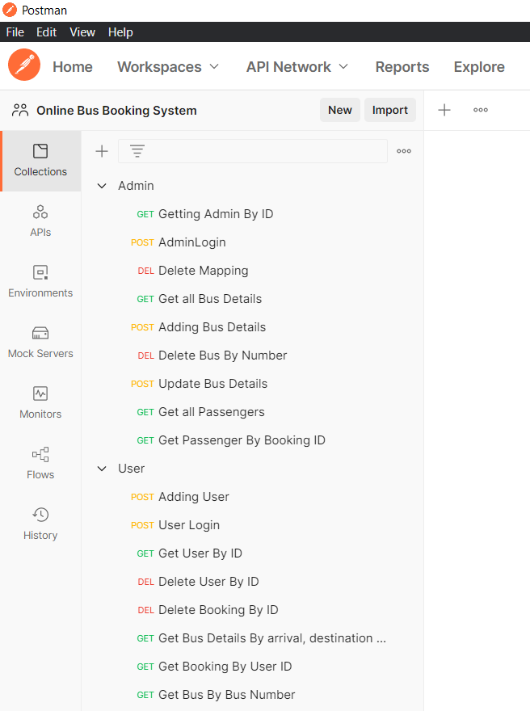
Postman Client Functional Testing Modules

Slide 25
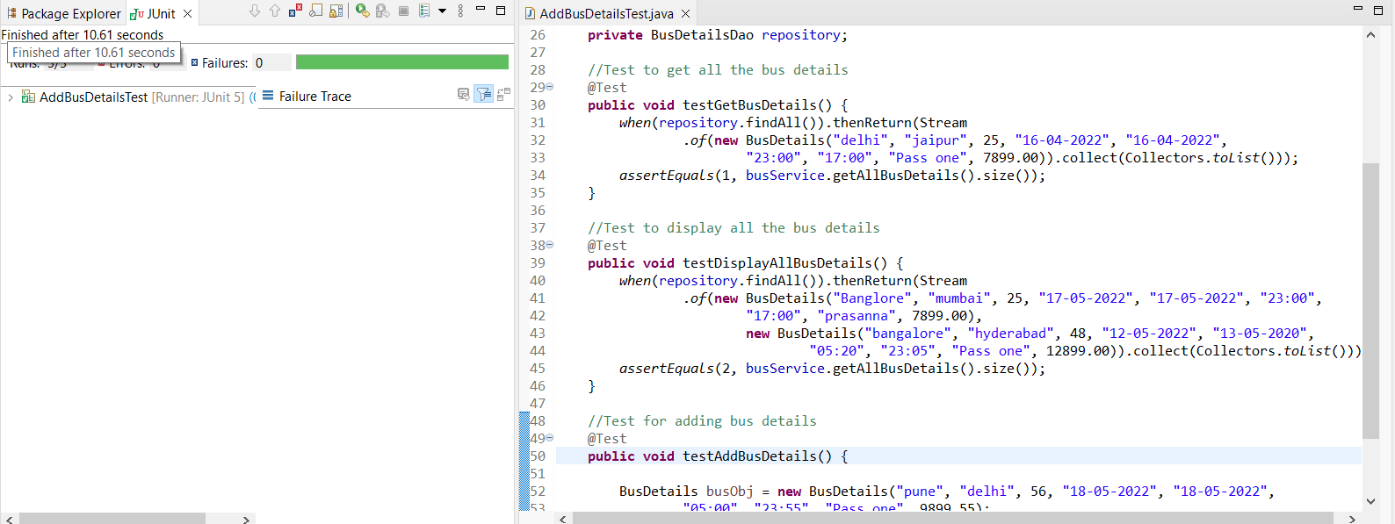
JUnit Tests

Slide 26
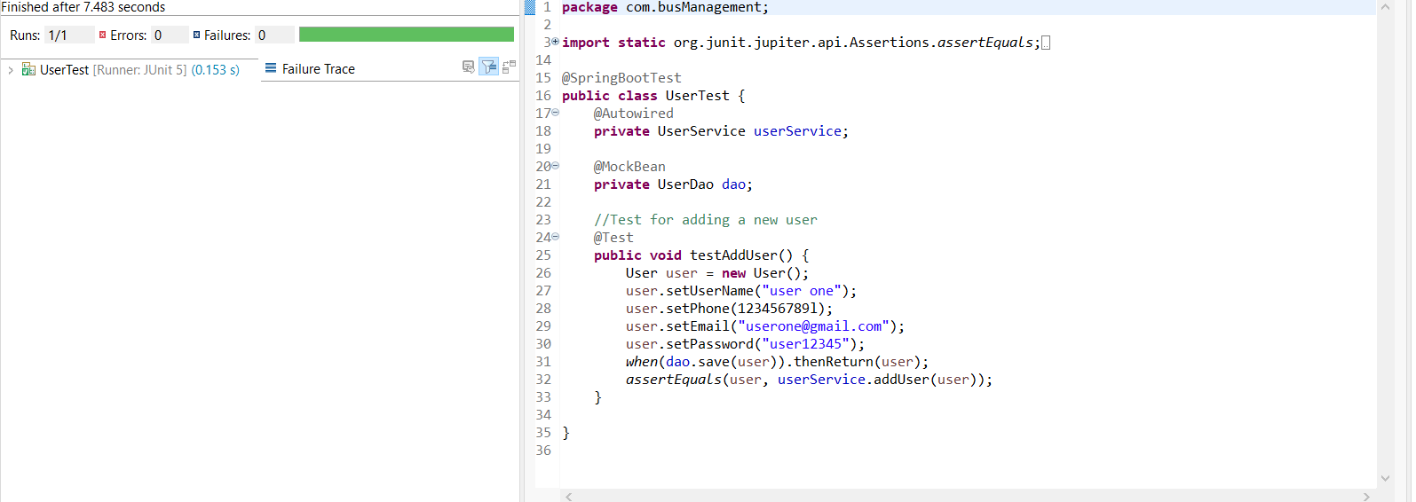
JUnit Tests

Slide 27
Technologies used in Frontend :-
VisualStudio Code IDE
Angular 13
Node js & Npm
TypeScript
Angular CLI
Bootstrap

Slide 28
ANGULAR :
Angular is a framework and platform for building single-page client applications using HTML and Type script . Angular is written in Type Script.
Great for Single page applications.
Angular is modular.
Built-in features DI, data binding etc.

Slide 29
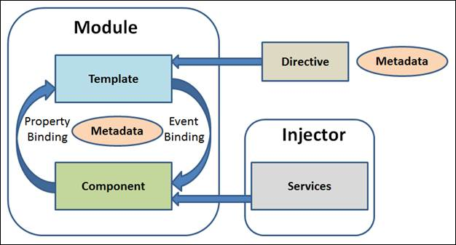
ANGULAR Architecture :

Slide 30
Angular Module :
Angular applications are modular and Angular has its own modularity system called Ng Modules. Ng Modules are containers for a cohesive block of code dedicated to an application domain, a workflow, or a closely related set of capabilities They can contain components, service providers, and other code files whose scope is defined by the containing Ng Module. They can import functionality that is exported from other Ng Modules, and export selected functionality for use by other Ng Modules.
Imports in module:
FormsModule
ReactiveFormsModule
HttpClientModule
BrowserModule
AppRoutingModule
NgbModule

Slide 31
Angular Routing:
The Angular Router is an object that enables navigation from one component to the next component as users perform application tasks like clicking on menus links, buttons or clicking on back/forward button on the browser. We can access the router object and use its methods like navigate() or navigateByUrl(), to navigate to a route.
Router Link:
The Router Link is a directive that binds the HTML element to a Route. Clicking on the HTML element, which is bound to a Router Link, will result in navigation to the Route. The Router Link may contain parameters to be passed to the route’s component.

Slide 32
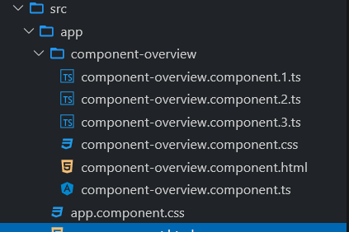
Angular Components:
Components are the most basic UI building block of an Angular app. An Angular app contains a tree of Angular components. Angular components are a subset of directives, always associated with a template. Unlike other directives, only one component can be instantiated for a given element in a template.
Each component consists of:
An HTML template that declares what renders on the page
A TypeScript class that defines behavior
A CSS selector that defines how the component is used in a template
Optionally, CSS styles applied to the template

Slide 33
Angular Components in the project
Home:
It is the Landing Page of the application. It has Navigation to Login and Register
Admin-Login:
Admin contains a page for login form and method to validate the Admin Login
User-Login:
User Login contains a page for user login form and a method to validate the user login.
User-Register:
This component contains a page for user registration form and method to store the details in Database.

Slide 34
Admin-Home:
After log-in as Admin, admin can perform two functional operations. Adding new Bus and viewing all the entries. This home page has an option to navigate the admin to perform these functionalities.
Add-Bus-Details:
This component contains a form inside a template page to add new bus details and TS file containing method to store the data entered in form into the database.
View-All-Bus-Details:
This component contains a viewing page which shows all the details and list of all the bus details and functionalities like updating bus details and deleting the existing bus from database.

Slide 35
User-Home:
After Login as User, User has 4 Functionalities Book Tickets for passengers, View Bookings, View User Details, Update User Details. This component contains the option to search the bus for user provided routing details and Route the user to add passenger details. This page also navigate the user to View Booking, View User Details, Update User Details.
Add-Passengers:
After selecting the bus, User needs to submit the passenger details of passengers in the form to store the data in the Database.
Show-User-booking:
This component contains all the bookings made by the logged in user. Can view the passenger and bus details for a specific booking.

Slide 36
Update-Passengers:
This component contains a form to update the passenger details and change it in data base.
View-User-details:
This component displays the user details.
Update-User:
This component contains a form to update the user details.
Error:
This component handles the error
Page-not-found:
This component handles 404 Error.

Slide 37
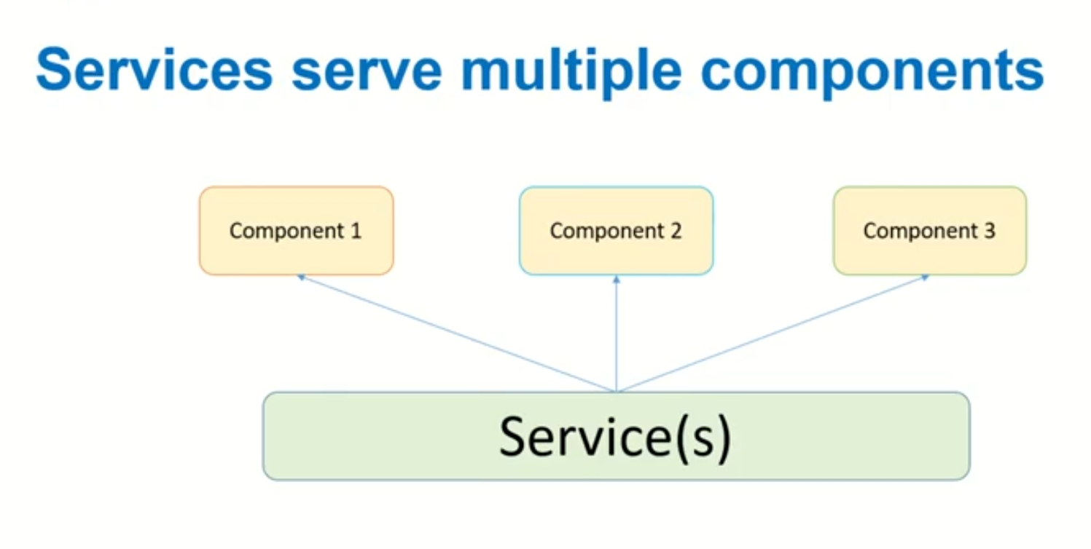
Angular Services:
Service is a piece of reusable code with a focused purpose. A code that you will use across multiple components in your application.
Our components need to access the data. You can write data access code in each Component, but this is very inefficient and breaks the rule of single responsibility. The Component should focus on presenting the data to the user.
Command to generate service: ng g s <service_name>
There are two services in this application
Admin-Service
User-Service

Slide 38
Admin Service:
adminLogin()
getAdminDetails()
addBus()
modifybus()
removebus()
viewAllbus()
errorHandler()
User-Service:
addUser()
UserLogin()
addBooking()
getBookingbyUser(id)
deleteBooking()
updateUser()
getUser()
getBusbyNumber(busNumber)
addPassenger()
updatePassenger(passenger)
errorHandler

Slide 39
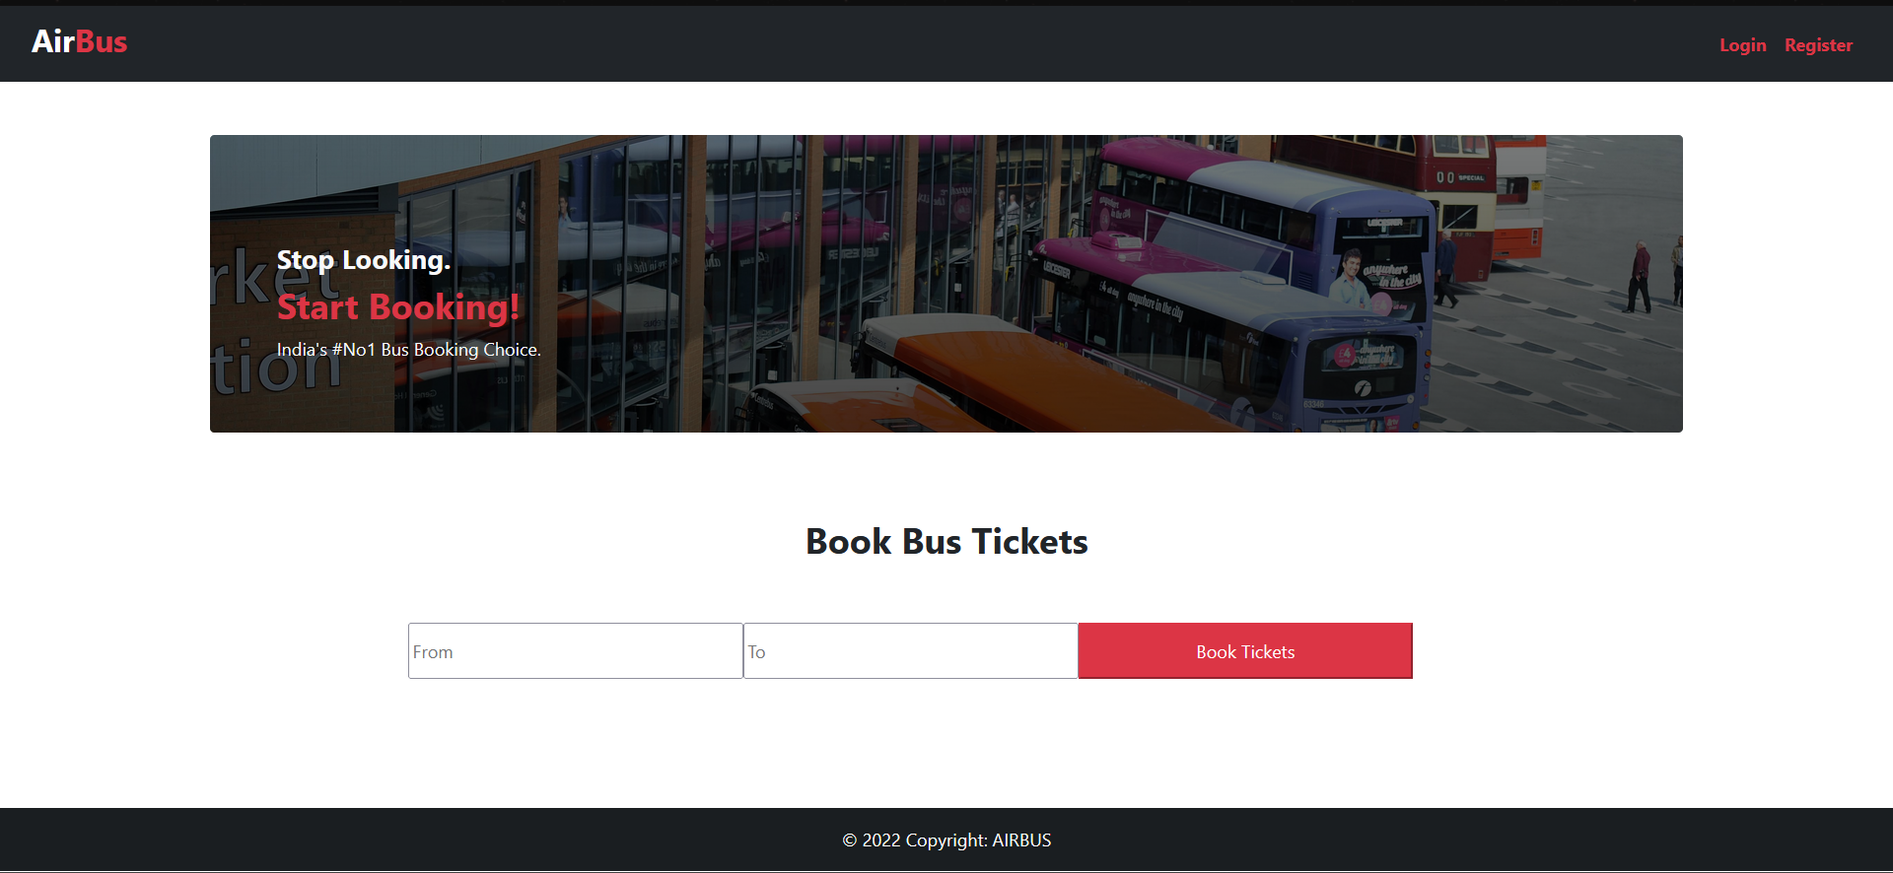
Home Page(Landing Page)

Slide 40
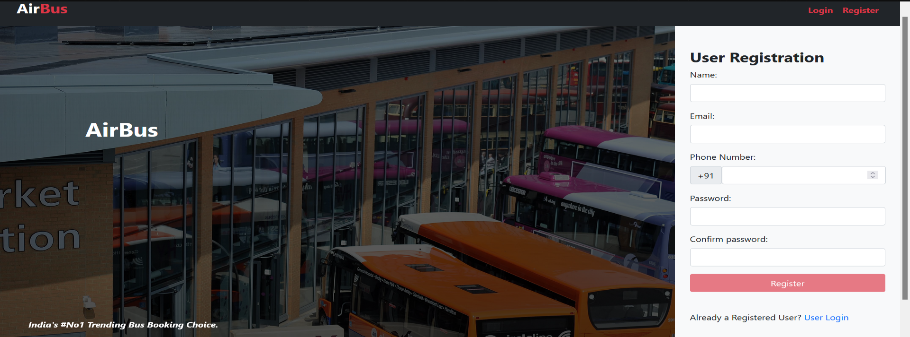
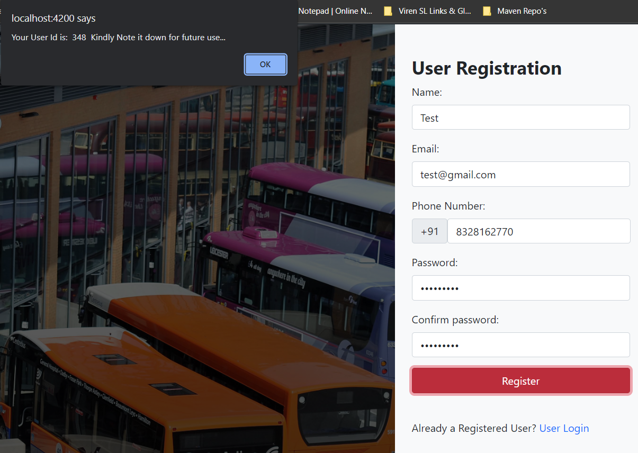
User Registration

Slide 41
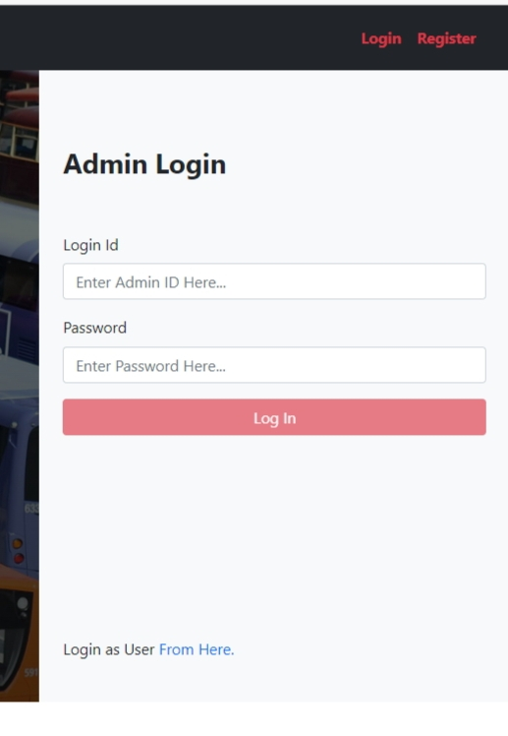
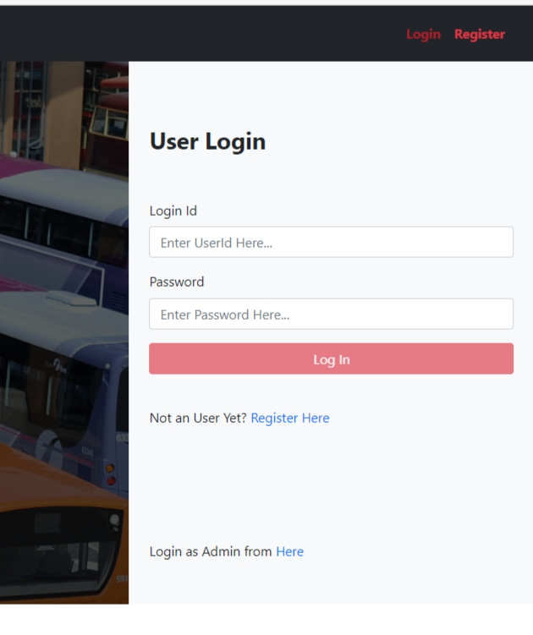
Admin & User Login

Slide 42
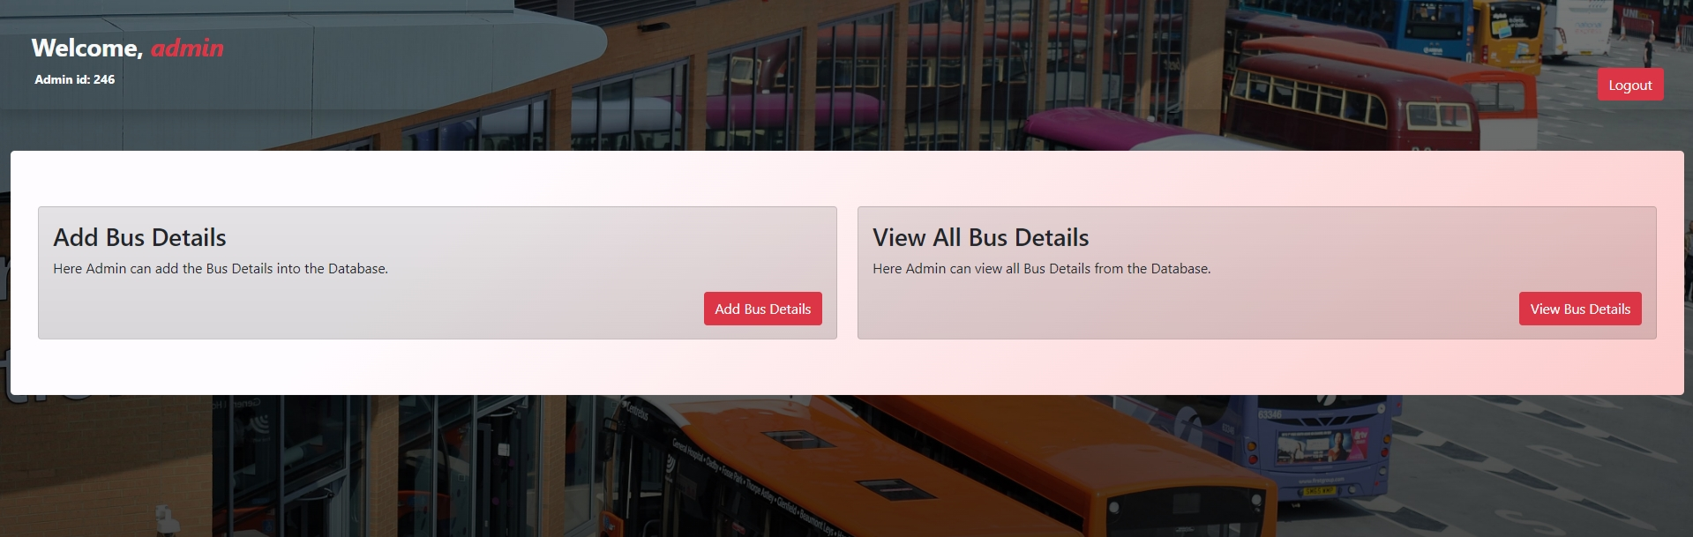
Admin home page :
In this admin page, admin can add bus details and he can view bus details

Slide 43

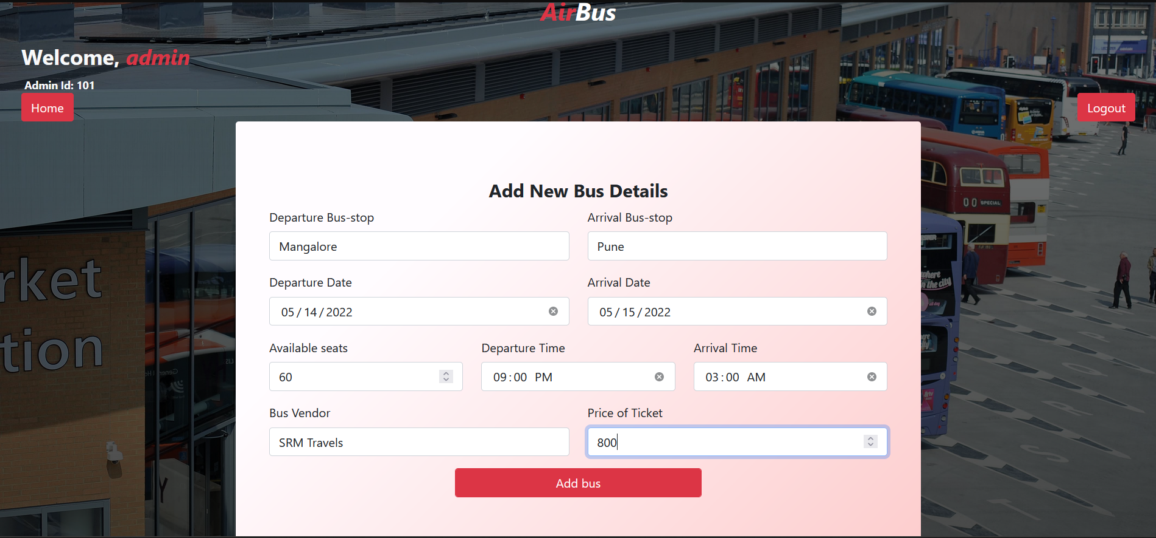
In this admin can add departure and arrival details of a bus

Slide 44

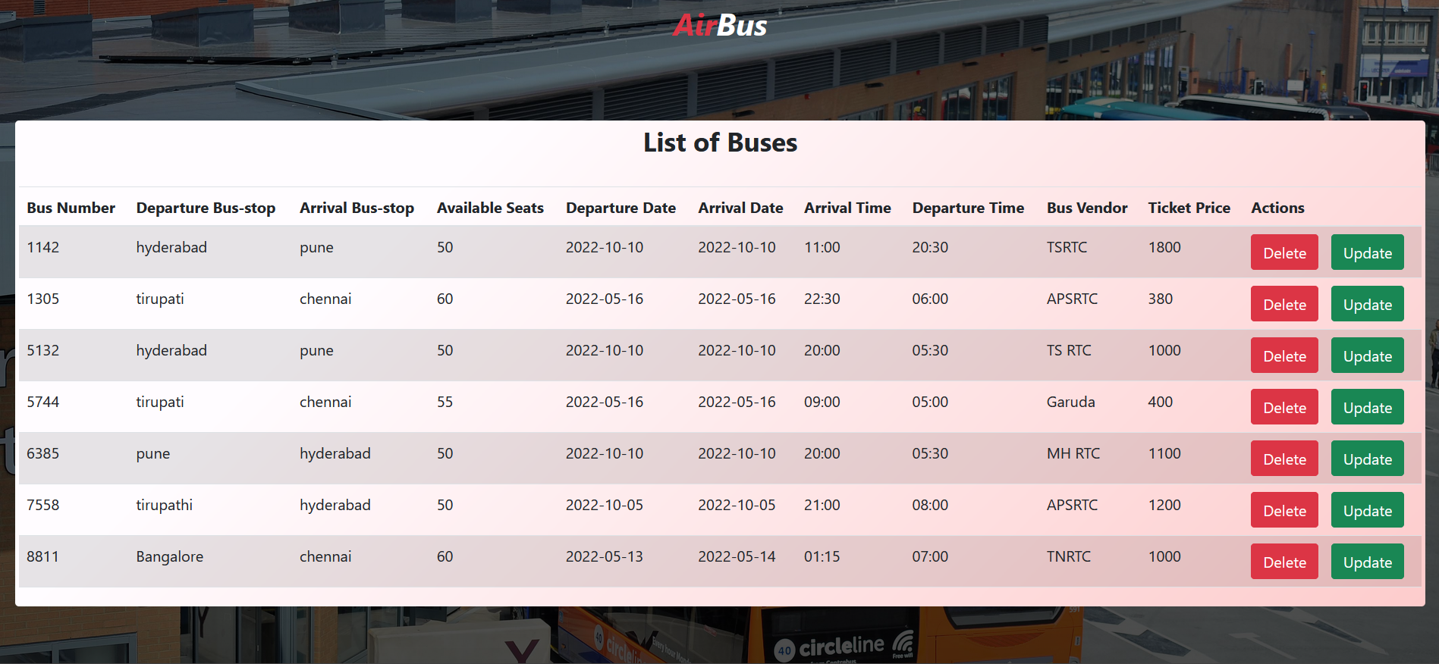
Admin can view the bus details which he added or updated

Slide 45
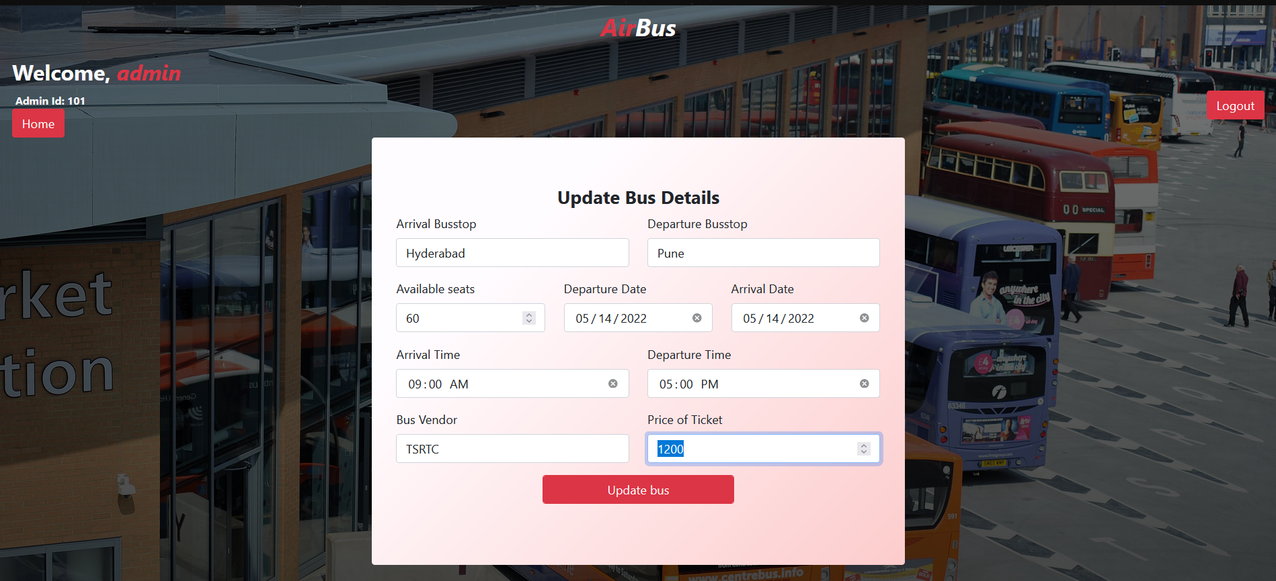
Admin can update bus details

Slide 46
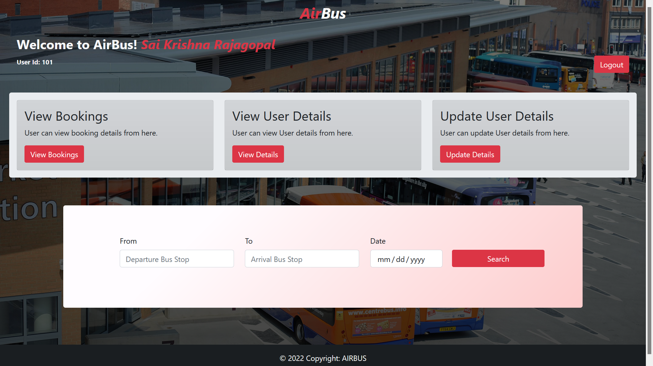
USER home page: here user can view bus details and he can book tickets

Slide 47
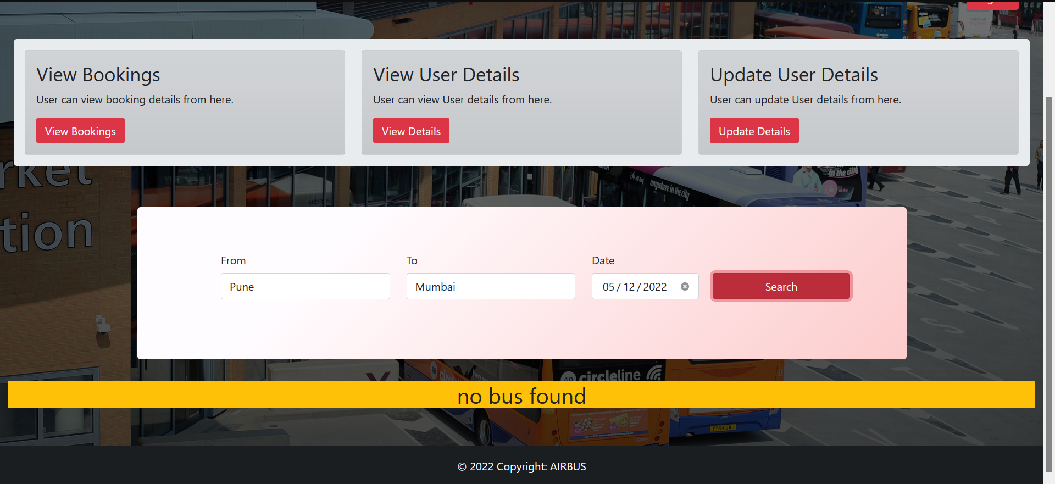
USER home page: Not Valid Search
Here user is seeing no bus found message because there might be 2 reasons one is admin did not added the bus details
or else there is no bus for that particular route.

Slide 48
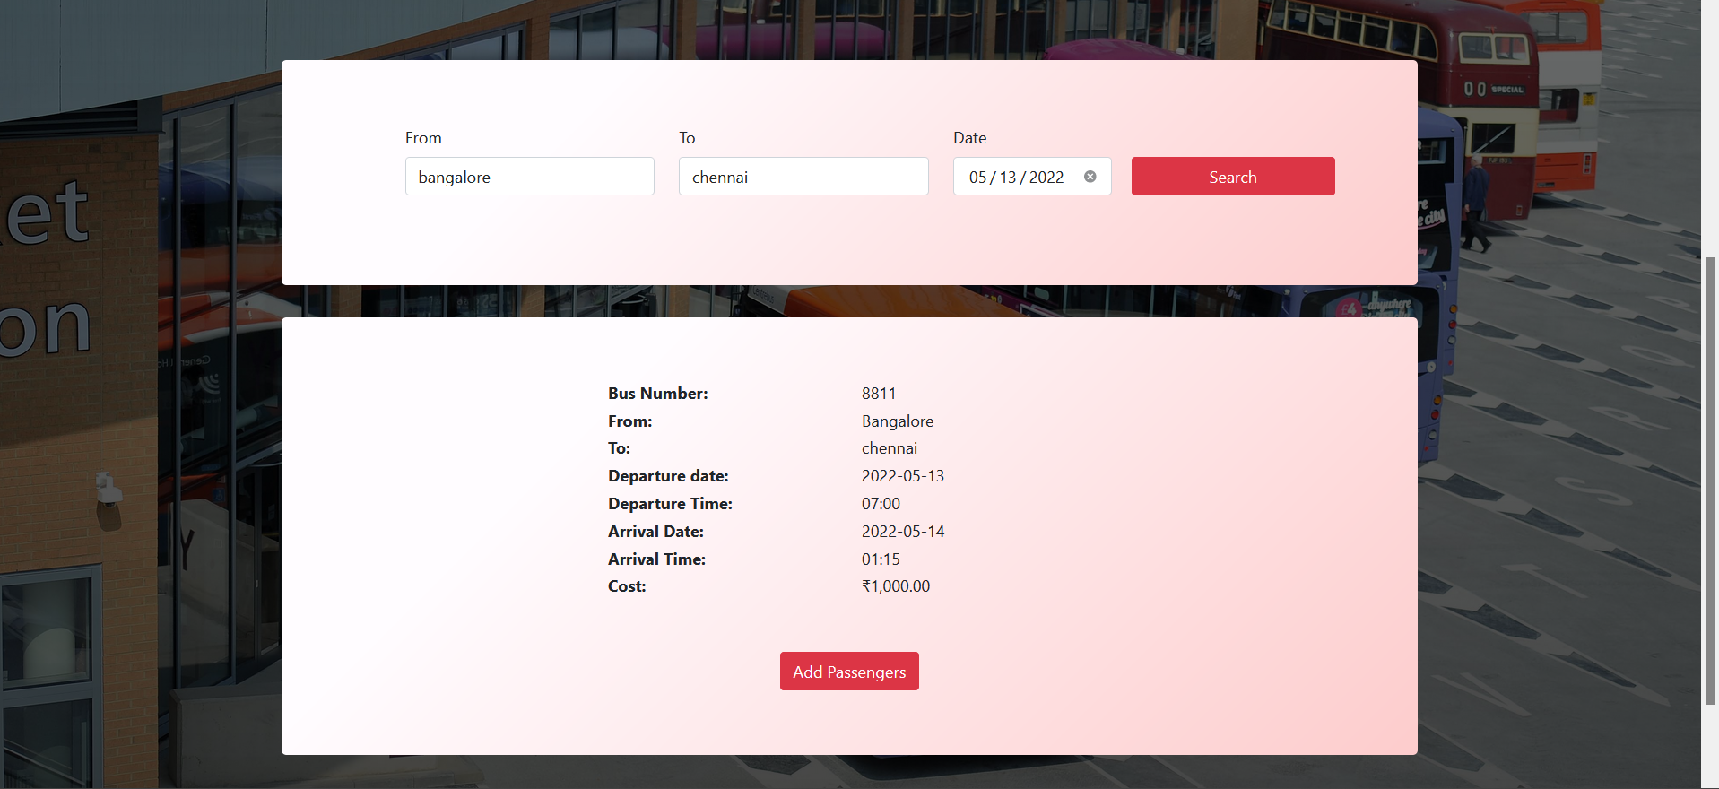
USER home page: Valid Search

Slide 49
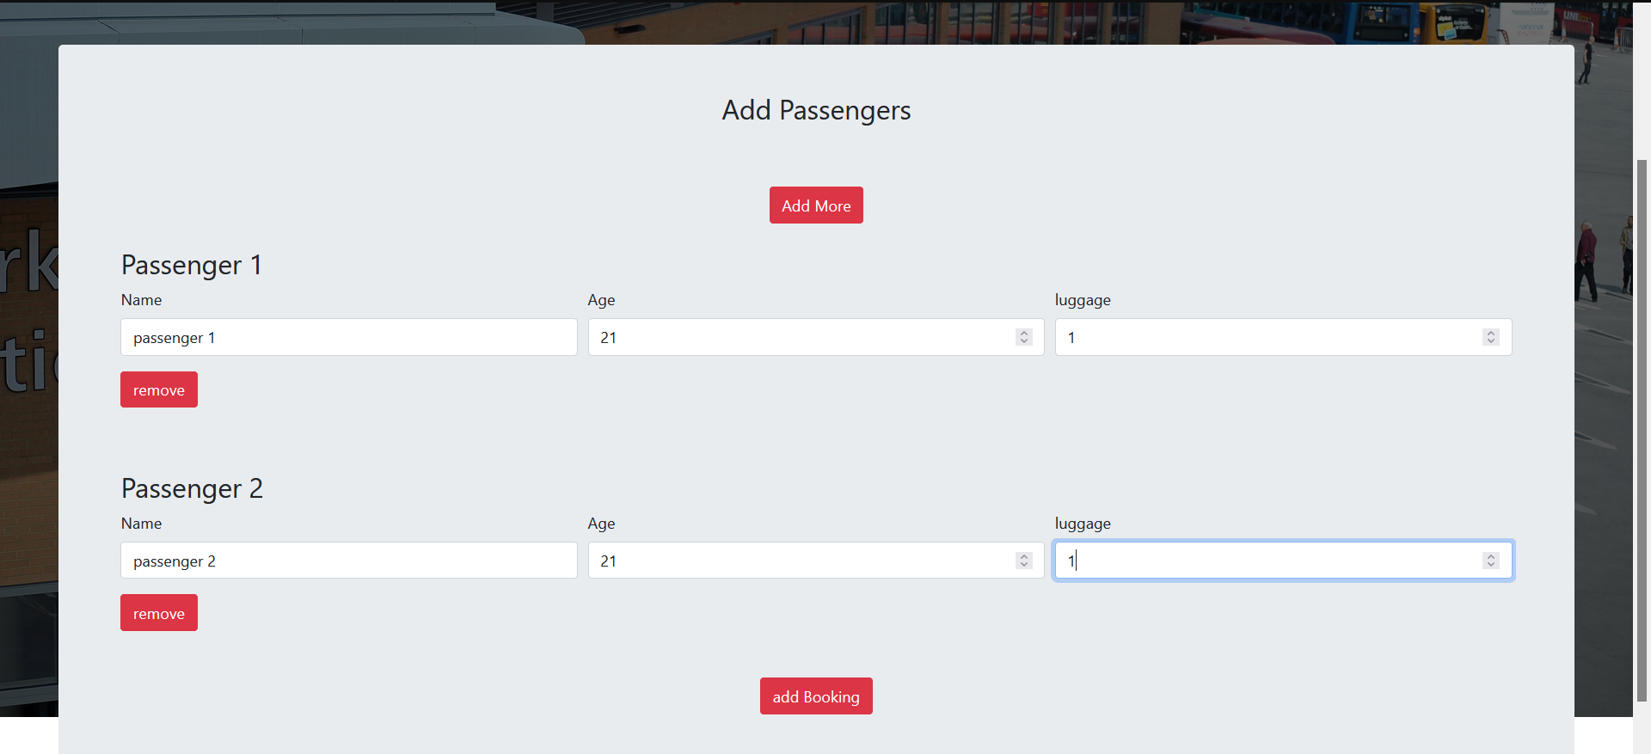
Adding Passengers

Slide 50
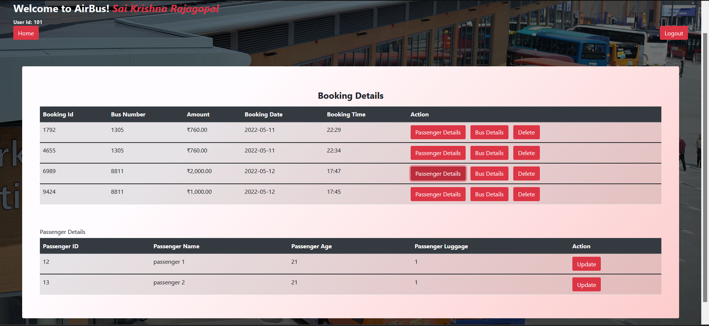
Viewing-Booking-byUser
Passenger Details

Slide 51
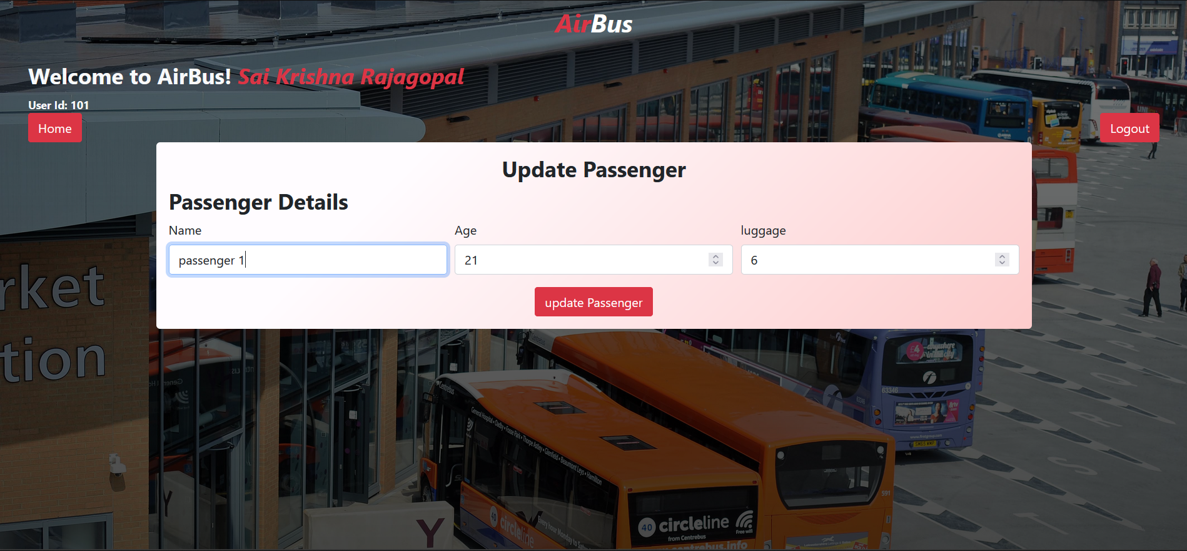
Update User Details

Slide 52
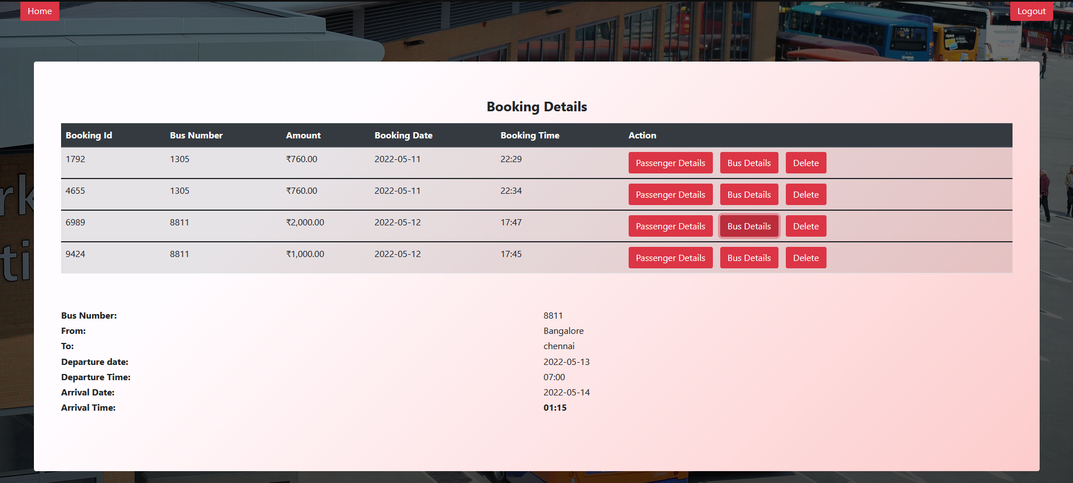
Bus Details in Booking

Slide 53
Update Passenger

Slide 54
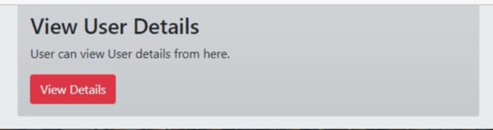
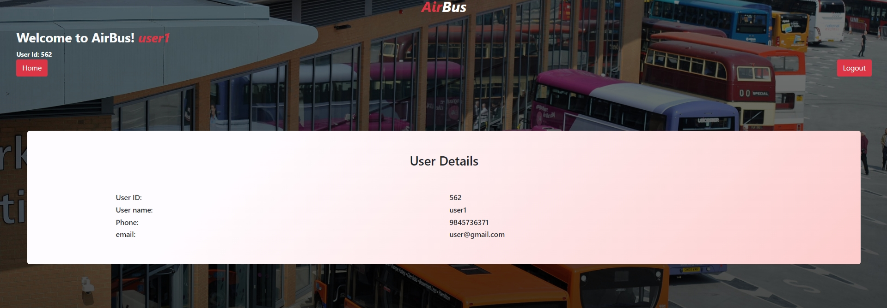
User can view his details

Slide 55
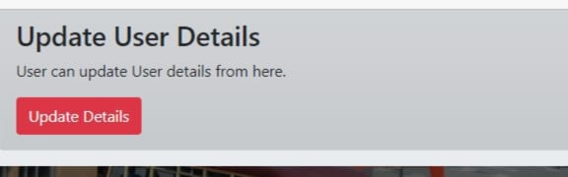
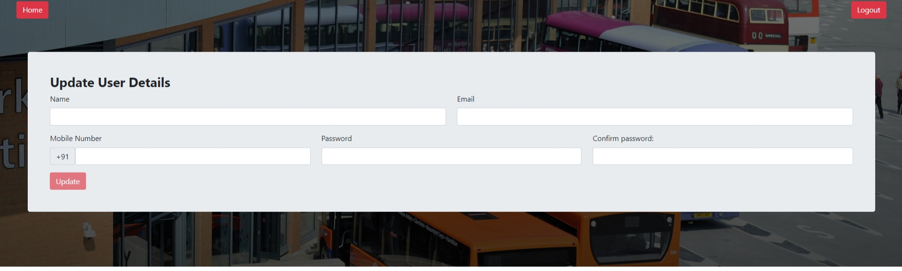
User can update his details

Slide 56


